Slide 1
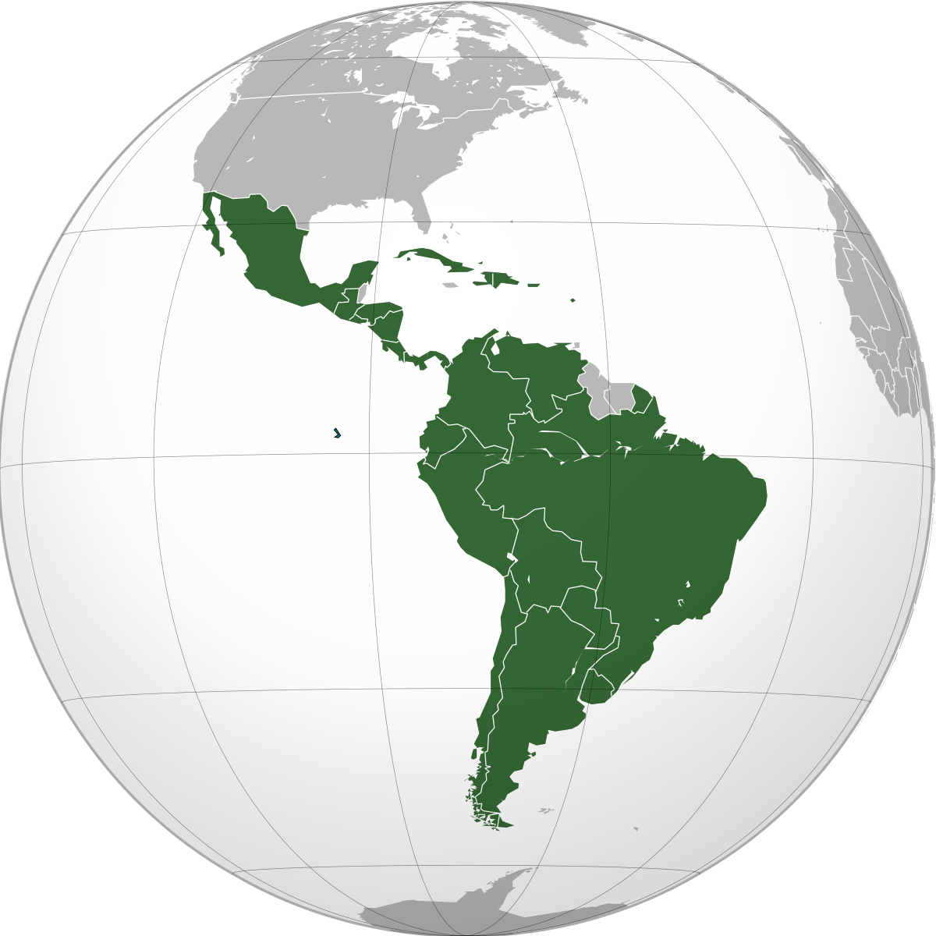
Latin America

Slide 2
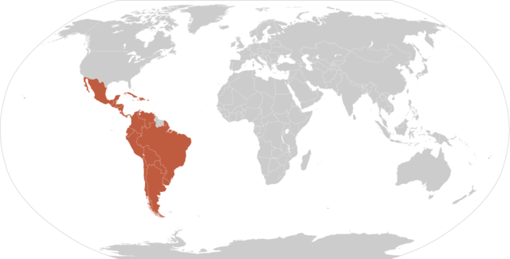
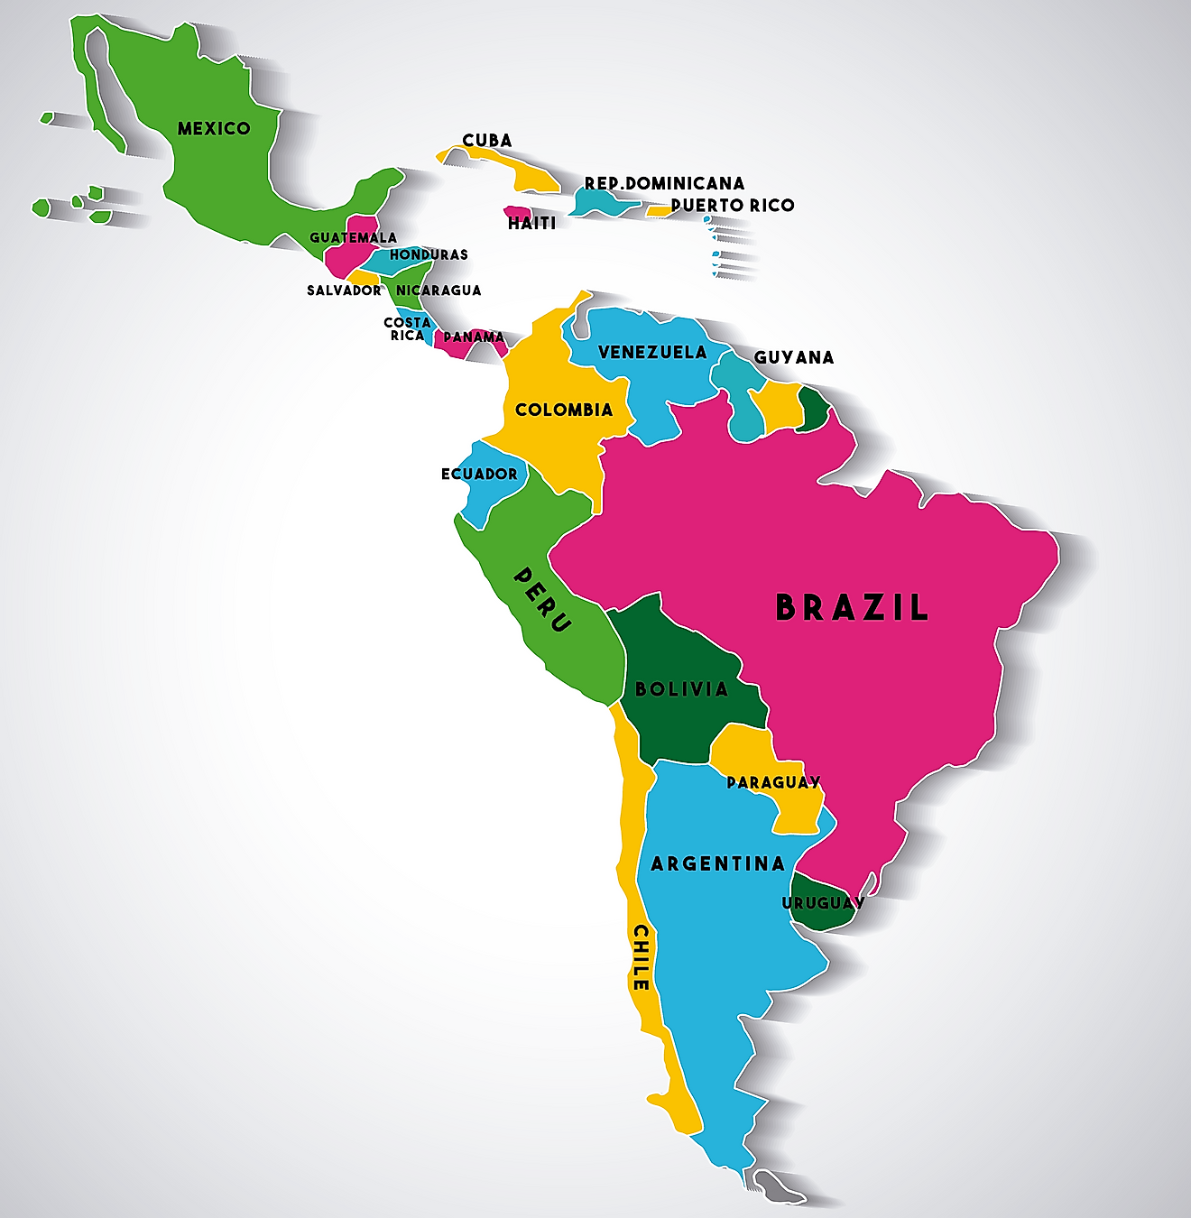
Latin America is generally understood to consist of the entire continent of South America in addition to Mexico, Central America, and the islands of the Caribbean whose inhabitants speak a Romance language. The peoples of this large area shared the experience of conquest and colonization by theSpaniards and Portuguese from the late 15th through the 18th century as well as movements of independence from Spain and Portugal in the early 19th century. Even since independence, many of the various nations have experienced similar trends, and they have some awareness of a common heritage.
www.britannica.com/place/Latin-America

Slide 3
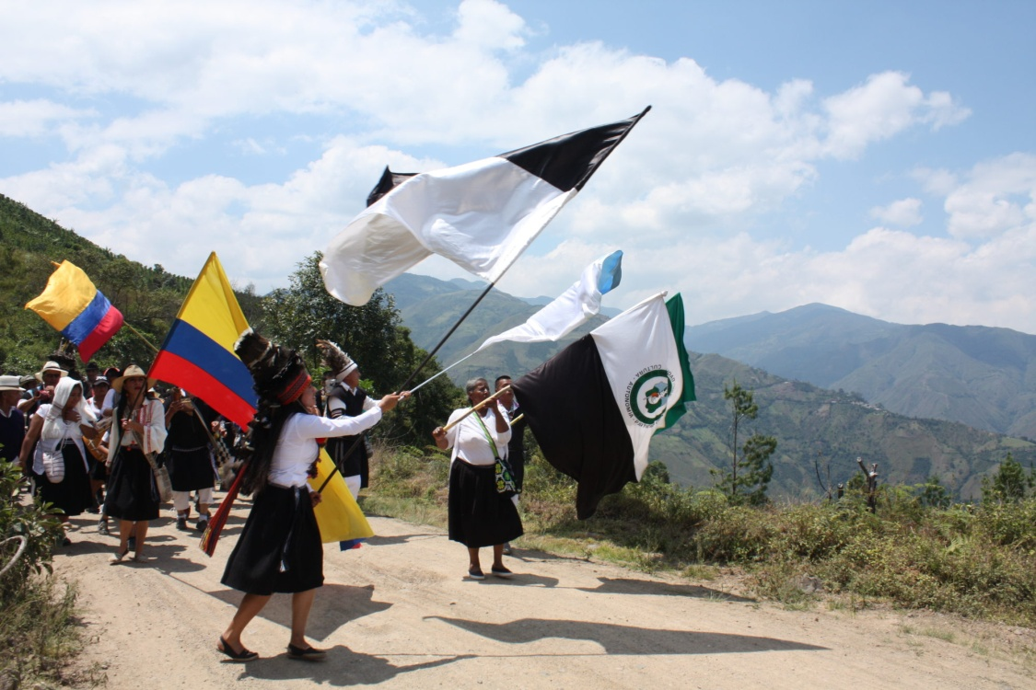
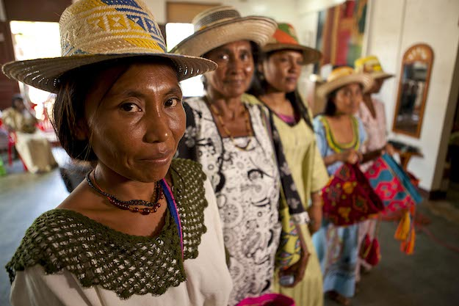
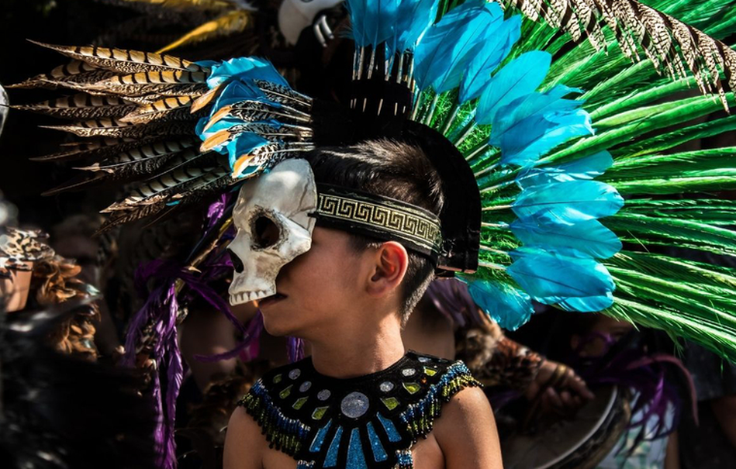

Slide 4
Standards
SS6G1 Locate selected features of Latin America.
Locate on a world and regional political-physical map: Amazon River, Amazon Rainforest, Caribbean Sea, Gulf of Mexico, Atlantic Ocean, Pacific Ocean, Panama Canal, Andes Mountains, Sierra Madre Mountains, and Atacama Desert.
b. Locate on a world and regional political-physical map the countries of Brazil, Chile,
Colombia, Cuba, Mexico, and Panama.
SS6G2 Explain the impact of environmental issues in Latin America.
Explain the causes and effects of air pollution in Mexico City, Mexico.
Explain the environmental issue of destruction of the rain forest in Brazil.
SS6H1 Explain conflict and change in Latin America.
b. Describe the influence of the Spanish and the Portuguese on the language and religions of Latin America.
d. Explain the impact of poverty, the war on drugs, and migration to the United States on Latin America.

Slide 5
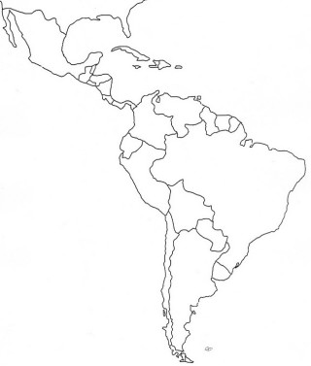
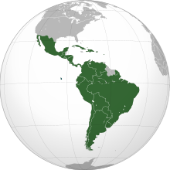
8
B
Latin America
1
M
D
M
2
C
A
3
e
5
4
H
G
F
G
7
H
K
6
H

Slide 6
Students will begin working on their Social Studies Project.
This project will have two parts (Martin Luther King and Latin America Leaders).

Slide 7
Monday, January 9
Standard:
SS6G1 Locate selected features of Latin America.
SS6G2 Explain the impact of environmental issues in Latin America.
SS6H1.b Explain conflict and change in Latin America.
Learning Target: Explain the impact of environmental issues (air pollution and destruction of rain forest) in Latin America; Explain conflict and change in Latin America (Describe the influence of the Spanish and the Portuguese on the language and religions of Latin America).
Warm-up: Latin America Study Map (complete answer key)
Work Session: Cloze Notes (Brain Wrinkles);Textbook p.346, 401; Environmental issues of Latin America (air pollution and destruction of rain forest).
Students will begin working on Social Studies Project (MLK/ Latin American Leaders)
Closing: TOD
Reminders: Quiz on Wednesday will cover G1,G2, H1b

Slide 8
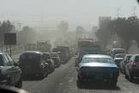
Air Pollution in Mexico City
Mexico City was once named as the world’s most polluted city in the world, but according to IQAir, a Swiss company which keeps track of the air quality of cities around the globe, Mexico City has now dropped down to the 917th most polluted city in the world in 2021. Though its concentration of airborne particles (PM 2.5) still currently exceeds the guideline of the World Health Organization (WHO), yet the colossal improvement is undoubtable. What has been done to successfully reduce air pollution in Mexico City? And what lessons can other cities learn from it?

Slide 9
Tuesday, January 10
Standard:
SS6G1 Locate selected features of Latin America.
SS6G2 Explain the impact of environmental issues in Latin America.
SS6H1.b Explain conflict and change in Latin America.
Learning Target: Explain the impact of environmental issues (air pollution and destruction of rain forest) in Latin America; Explain conflict and change in Latin America (Describe the influence of the Spanish and the Portuguese on the language and religions of Latin America).
Warm-up: Latin America Study Map (complete answer key)
Work Session: Cloze Notes (Brain Wrinkles); Textbook p.346, 401; Environmental issues of Latin America (air pollution and destruction of rain forest). Video: Spain/Portugal colonization of Latin America; TB p.322-323
Students will begin working on Social Studies Project (MLK/ Latin American Leaders)
Closing: Think-Pair-Share
Reminders: Quiz on Wednesday will cover G1,G2, H1b

Slide 10
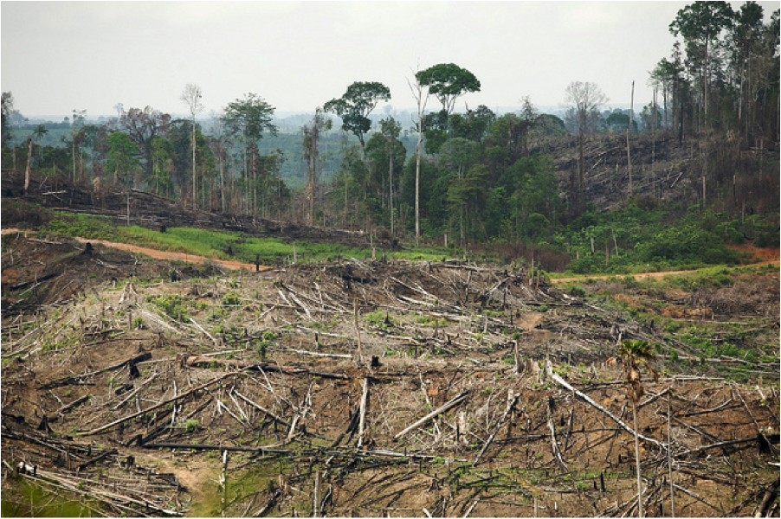
Destruction of the rain forest in Brazil
Humans are the main cause of rainforest destruction. We are cutting down rainforests for many reasons, including:
wood for both timber and making fires;
agriculture for both small and large farms;
land for poor farmers who don’t have anywhere else to live;
grazing land for cattle;
pulp for making paper;
road construction; and
extraction of minerals and energy.
An estimated 18 million acres (7.3 million hectares) of forest — roughly the size of Panama

Slide 11
Wednesday, January 11
Standard:
SS6G1 Locate selected features of Latin America.
SS6G2 Explain the impact of environmental issues in Latin America.
SS6H1.b Explain conflict and change in Latin America.
Learning Target: Explain the impact of environmental issues (air pollution and destruction of rain forest) in Latin America; Explain conflict and change in Latin America (Describe the influence of the Spanish and the Portuguese on the language and religions of Latin America).
Warm-up: Latin America Study Map (complete answer key)
Work Session: Cloze Notes (Brain Wrinkles); Textbook p.346, 401; Environmental issues of Latin America (air pollution and destruction of rain forest). Video: Spain/Portugal colonization of Latin America; TB p.322-323
Students will begin working on Social Studies Project (MLK/ Latin American Leaders)
Closing: Class Summarize
Reminders: Quiz on Wednesday will cover G1,G2, H1b

Slide 12
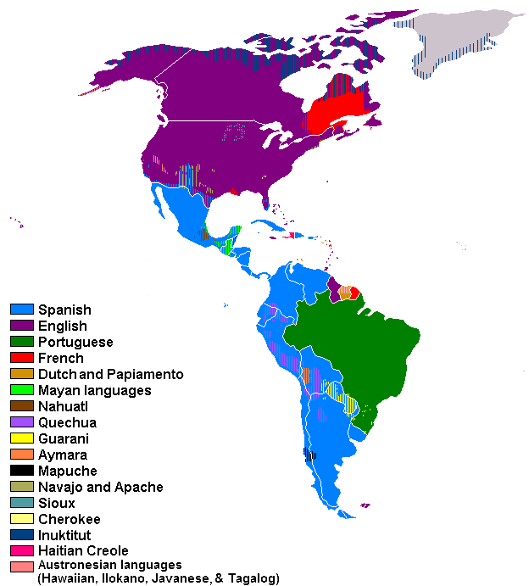
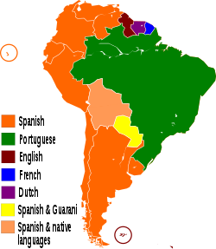
Languages of Latin America:
1) Spanish 2) Portuguese 3) English 4) German 5) Italian

Slide 13
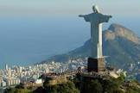
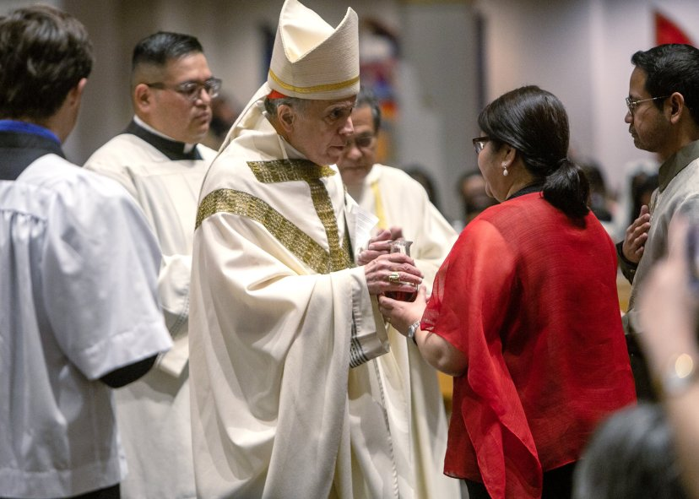
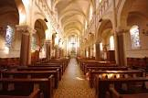
The majority of Latin Americans are Christians (90%), mostly Roman Catholics.

Slide 14
Thursday, January 12
Standard:
SS6G1 Locate selected features of Latin America.
SS6G2 Explain the impact of environmental issues in Latin America.
SS6H1.b Explain conflict and change in Latin America.
Learning Target: Explain conflict and change in Latin America (Describe the influence of the Spanish and the Portuguese on the language and religions of Latin America).
Warm-up: Video: Roman Catholic Religion
Work Session: Cloze Notes (Brain Wrinkles); Spain/Portugal colonization of Latin America; TB p.322-323;
Languages of Latin America and Religions of Latin America.
Closing: Three things I Learned and Three Questions (to be asked by other classmates)
Reminders:

Slide 16
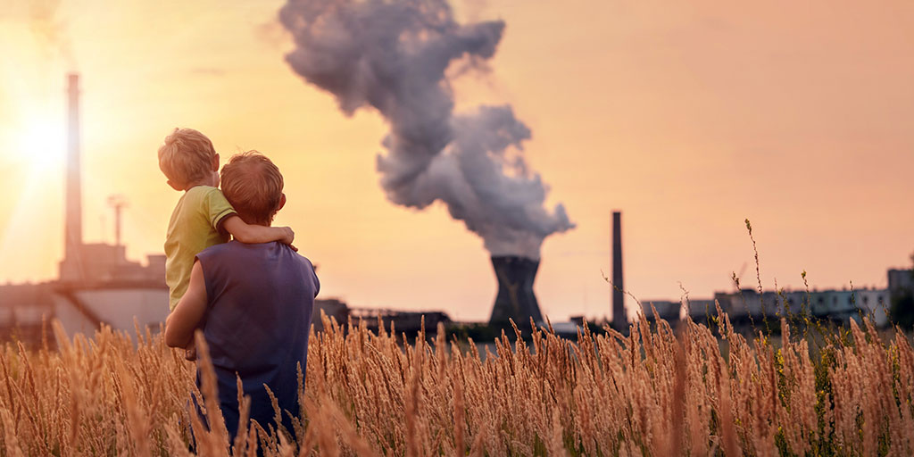
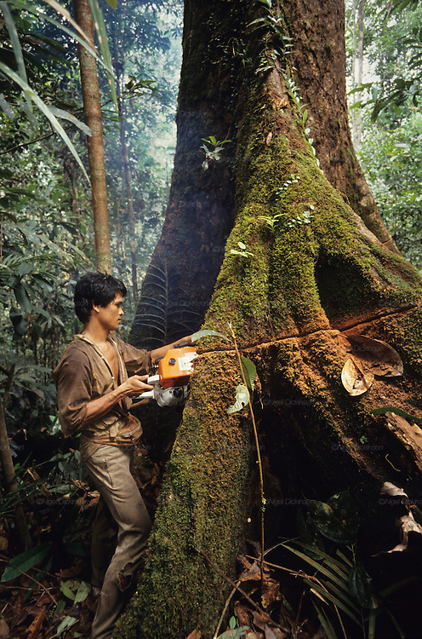

Slide 17
Friday, January 13
Standard:
SS6G1 Locate selected features of Latin America.
SS6G2 Explain the impact of environmental issues in Latin America.
SS6H1.b Explain conflict and change in Latin America.
Learning Target: Explain conflict and change in Latin America (Describe the influence of the Spanish and the Portuguese on the language and religions of Latin America).
Warm-up: Video: Spanish Language
Work Session: Cloze Notes (Brain Wrinkles); Latin America Map; Spain/Portugal colonization of Latin America; TB p.322-323; Languages and Religions of Latin America.
Closing: TOD
Reminders:

Slide 18
Questions:
What type of environmental issue does Mexico City face?
What is the biggest cause for this pollution?
What physical features of Mexico City add to the problem?
What measures are the Government putting into place to help solve this problem?
Why is the rainforest important?
List some reasons why the rainforest is being destroyed?
How doe this impact the environment and the world?

